Slide 1

ELECTRIC FOLDABLE VEHICLE
Major Project phase-1
Presented by
Under the guidance of
Dr. A. SREENIVASULU REDDY
Assistant Professor
DEPARTMENT OF MECHANICAL ENGINEERING
SRI VENKATESWARA UNIVERSITY COLLEGE OF ENGINEERING
TIRUPATI-517502

Slide 2
Contents
Abstract
Introduction
Literature Review
Design model
Importace of Electric Foldable Vehicle
Componets of Electric Foldable Vehicle

Slide 3
ABSTRACT
The world's population is growing but its surface area is contracting. The moment has come to consider a vehicle that can be folded up easily and transported anywhere because our world is moving toward a more compact size.
Our project's main goal is to create a portable vehicle that is simple to operate for handicapped and older people. We also considered parking issues when designing the project and chose to create a portable suitcase vehicle that is simple to fold. So, after usage, a suitcase be folded, transported as luggage, and stored at home or another location that has space for a suitcase of that size.

Slide 4
INTRODUCTION
Electric vehicles are considered to be 97% cleaner, producing no tailpipe emissions that can place particulate matter into the air. Particulate matter, carcinogens released into the atmosphere by gas-powered vehicles can increase asthma conditions as well as irritate respiratory systems while EV does not create any such problems.
Three-wheeled EV enable people with certain disabilities to transit independently.
This project is another step towards the development of electric vehicle scenario. This e-moped is having features like folding mechanism for solving parking problems, three wheels for better stability and compact size which helps surfing easily in crowdie areas.

Slide 5
Literature review
In their research report, Bjarni Freyr Gudmundson and Mr. Esben Larsen reviewed alternative development methods for the folding electric motorcycle. They created a conceptual design and carried out thorough analyses of the specification, material choice, design and structural analysis, component choice, and test drive.
Mr. Sachin Achari and his associates worked hard on both the experimental analysis and project design in order to develop a portable vehicle that would be easy to use and transfer for both sexes.
Aditya Ganjapure, Palsh Kawale, Mangesh Deshapnde, etal-“Design and development of compact three wheeledfoldable electric moped.” Investigation has been done onelectric moped drive by BLDC Hub motor havingefficiency 84%.As seen in this report, with 18 km rangeon a single charge, a top speed of 13 kmph and an abilityto fold small enough to fit next to you in train or a bus, itcan act as an awesome last kilometre commutatervehicle also it is great way of transport for shortdistance and crowdie areas

Slide 6
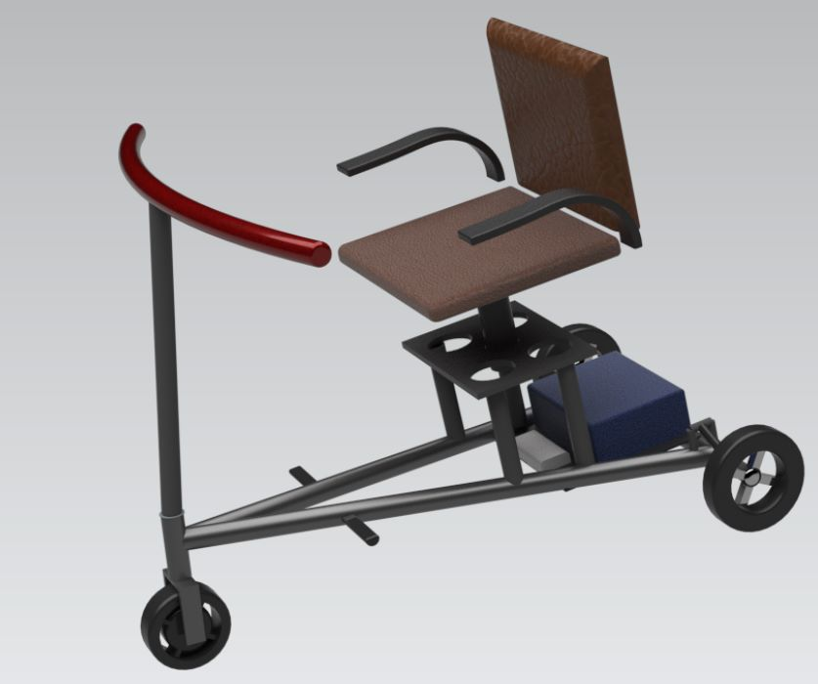
DESIGN MODEL

Slide 7
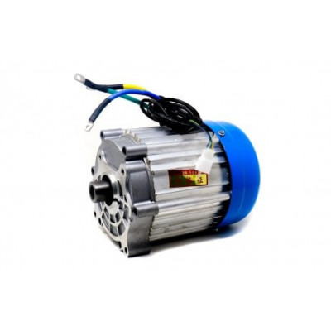
EFV COMPONETS
MOTOR
Rated Operating Voltage : 24V
Rated Power : 350W
Current : 14.6A(maximum)
No Load Speed : 500 RPM
Type : DC Brushless Hub Motor

Slide 8
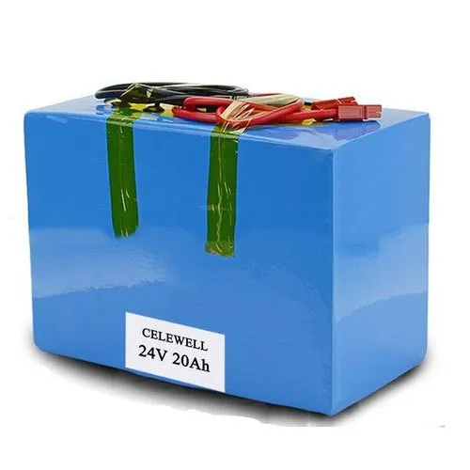
BATTERY
Capacity : 20Ah
Voltage : 24V
Casing : Metal
Cell : Cylidrical
Weight : 3.7kg - 4kg

Slide 9
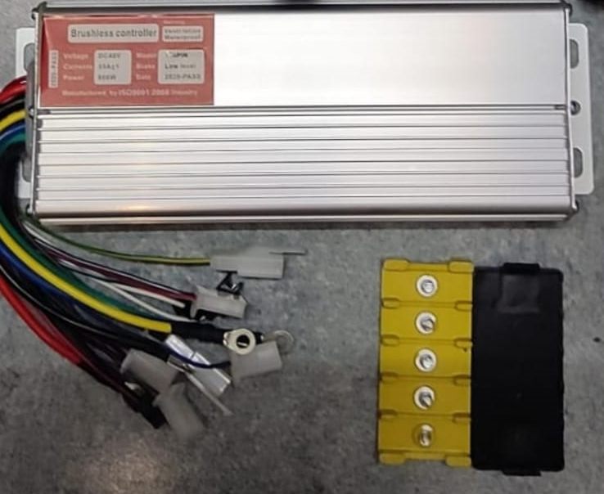
Motor Controller
The controller is like the brain of a vehicle, managing all of its parameters. It controls the rate of charge using information from the battery. It also translates pressure on the accelerator pedal to adjust speed in the motor inverter.
Voltage : 20V - 30V
Rated Power : 250W - 400W

Slide 10
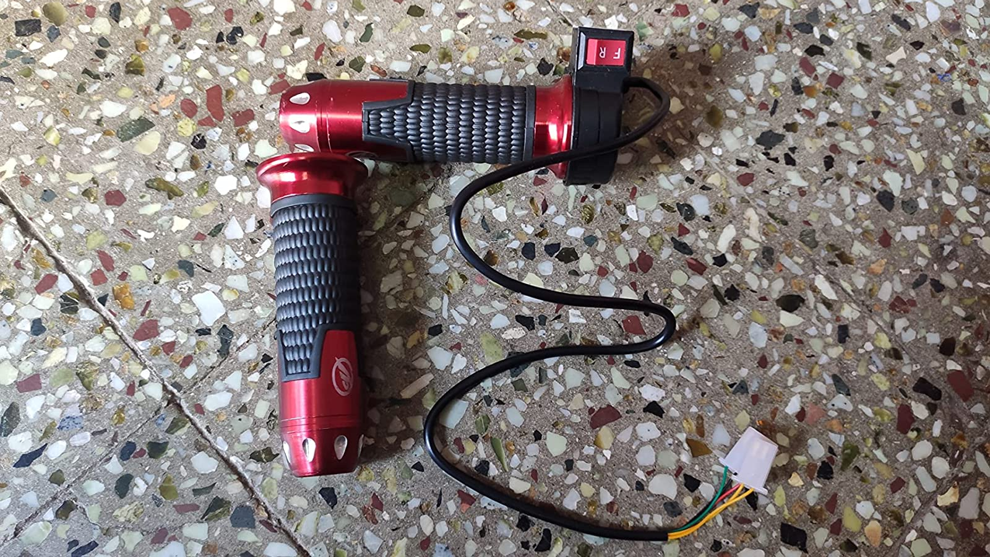
Throttle
Electric scooter throttle works by engaging the throttle while riding when you press or twist the throttle it signals the speed controller and battery to provide more power to the motor to accelerate.
Voltage:24V

Slide 11
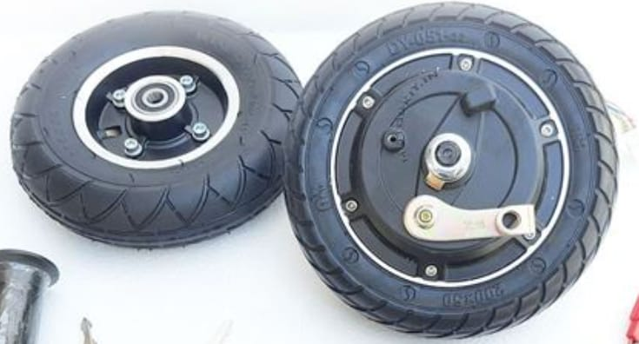
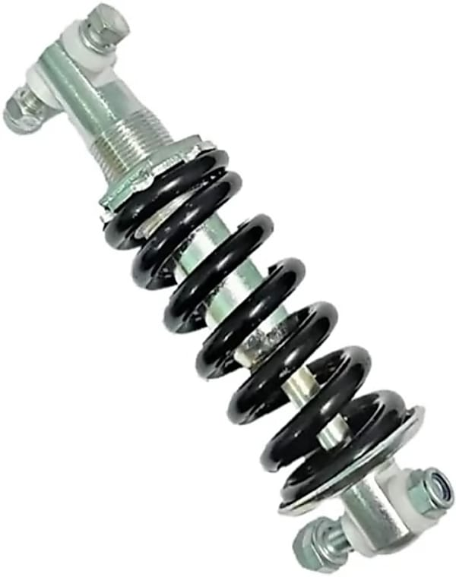
Wheel
Suspension
Three suspesions of 15cm are required.
Three 8 inch wheel’s are required.One front wheel with hub motor in it and two rear wheels.

Slide 12
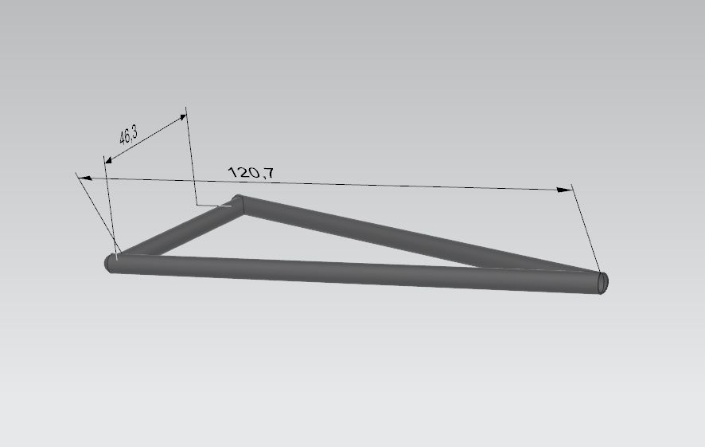
Chassis
Triangulation allows a chassis to be rigid and lightweight at the same time. Notice that despite having a single diagonal, the triangulated structure is rigid for forces applied to any corner in any direction in the plane of triangulation.
Shape : Triagualar
Material : Mild Steel

Slide 13
IMPORTANTANCE OF ELECTRIC FOLDABLE VEHICLE
Lower Running Cost
Low Maintain cost
Zero Carbon Emission
No Noise Pollution
Can be taken with us virtually anywhere
Conserves parking space

